Slide 1

ORGANIZATION AND MANAGEMENT
Bikash Adhikari
bikashadh044@gmail.com
Acknowledgement: Khem Gyawali
Mechanical Engineer

Slide 2

Objective of the course
This course aims to provide basic understanding of management concepts in organizations especially the following:
Acquire knowledge in the field of organizational management and internal organization of companies required for managing an enterprise.
Acquire knowledge in the field of personnel management, motivation and leadership for developing managerial skills
Gain knowledge for starting a small scale unit independently
Gain knowledge on case study and management information system.

Slide 3
Course outline
Introduction (20 hours)
1.1 Organization (2 hours)
System approach applied to Organization
Necessity of Organization
Principles of Organization
Formal and Informal Organizations
1.2 Management (4 hours)
Functions of Management
Levels of Management
Managerial Skills
Importance of Management
Models of Management

Slide 4
Course outline
Introduction (20 hours)
1.3 Theory of Management (6 hours)
Scientific Management Approach
Administrative Management Approach
Behavioral Management Approach
Modern Management Theories
1.4 Forms of Ownership (2 hours)
Single Ownership
Partnership
Joint Stock Company
Co – operative Societies
Public Corporations

Slide 5
Course outline
Introduction (20 hours)
1.5 Organizational Structure (2 hours)
Line Organization
Functional Organization
Line and Staff Organization
Committee Organization
1.6 Purchasing and Marketing Management (4 hours)
Purchasing
Functions of Purchasing Department
Methods of Purchasing
Marketing
Functions of Marketing
Advertising

Slide 6
Course outline
Personnel Management (8 hours)
2.1 Introduction
2.2 Functions of Personnel Management
2.3 Development of Personnel Policy
2.4 Manpower Planning
2. 5 Recruitment and Selection of manpower
2.6 Training and Development of manpower
2.7 Job Analysis, Job Evaluation and Merit Rating
2.8 Wages and Incentives

Slide 7
Course outline
3. Motivation, Leadership and Entrepreneurship (10 hours)
3.1 Motivation ( 2 hours)
Human needs
Maslow’s Hierarchy of needs
Motivation
Types of Motivation
Attitude Motivation; Group Motivation; Executive Motivation
Techniques of Motivation
Motivation Theories
McGregor’s Theory X – Y
Fear and Punishment Theory
Alderfer’s ERG Theory
MacClelland’s Theory of learned needs
Herzberg’s Hygiene Maintenance Theory
Vroom’s Expectancy/ Valency Theory

Slide 8
Course outline
3. Motivation, Leadership and Entrepreneurship (10 hours)
3.2 Leadership (6 hours)
Qualities of a good Leader
Leadership Style
Blakes and Mouton’s Managerial Grid
Leadership Approach
Leadership Theories
3.3 Entrepreneurship (2 hours)
Entrepreneurship Development
Entrepreneurial Characteristics
Need for Promotion of Entrepreneurship
Steps for establishing small scale unit

Slide 9
Course outline
4. Case Studies (2 hours)
4.1 Introduction
4.2 Objectives of case study
4.3 Phases of case study
4.4 Steps of case study
4.5 Types of case studies
5. Management Information System (5 hours)
5.1 Data and Information
5.2 Need, function and Importance of MIS
5.3 Evolution of MIS
5.4 Organizational Structure and MIS
5.5 Computers and MIS
5.6 Classification of Information Systems
5.7 Information Support for functional areas of management
5.8 Organizing Information Systems

Slide 10
Course outline
Note:
Students have to submit a case study report after visiting an industrial organization outside or inside the Kathmandu valley.
Reference Books:
M. Mahajan, “Industrial Engineering and production Management” ,Dhanpat Rai and Co. (P) Ltd. , Delhi, 2002
E. S. Buffa and R. K. Sarin “Modern Production / Operations Management”, 8th Edition, Wiley, 1987

Slide 11
Evaluation Scheme
Internal Assessment = 20 marks
I. Assignment: 3X 1 = 3
II. Assessment: 2 = 5
III. Attendance: 2
IV. Case study Report: 10
Final exam = 80 marks
Chapters | Hours | Marks distribution
1.1 & 1.2 | 6 | 8 or 16
1.3 | 6 | 8
1.4 & 1.5 | 4 | 8
1.6 | 4 | 8
2 | 8 | 16
3.1 | 6 | 8
3.2 & 3.3 | 4 | 8
4 & 5 | 7 | 8 or 16
Total | 45 | 80

Slide 12
Chapter 1 INTRODUCTION
Bikash Adhikari
Lecturer
‘There is nothing in a caterpillar that tells you it is going to be a butterfly.’

Slide 13
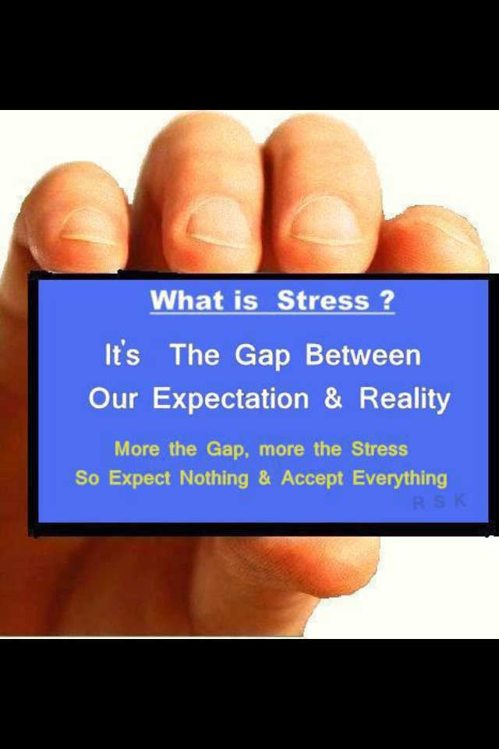
Organization- course outline
System approach applied to organization
Necessity of organization
Principles of organization
Formal and Informal organizations

Slide 14
1. Organization
“Organization is the form of every human association for the attainment of a common purpose”
- Mooney and Reiley.
‘An organization is a collection of people working together in a coordinated and structured fashion to achieve one or more goals.’
In common parlance:
Organization is a process of identifying and grouping the work to be performed, defining and delegating responsibility and authority and establishing relationships for the purpose of enabling people to work most effectively together in accomplishing objectives.

Slide 15
1. Organization
Organizations Role in Society
Organizations exist to allow accomplishment of work that could not be achieved by people alone.
As long as the goals of an organization are appropriate, society will allow them to exist and they can contribute to society.
Organizations and People
Organizations are strongly influenced by the people that form part of them.
Organizations can take in part of the personality of the people within them and their attitudes, perceptions and behaviors affect how an organization will operate.
Organizations Require Management
Organizations use management to accomplish the work that is required to achieve the goals.

Slide 16
Historical development of organization
The concept of organization grew along with growth of economic activities. Major stages of economic growth are:
Pre- industrial era
I. Self- sufficiency era (as in village area)
II. Commercial stage with marketable surplus
Barter system (exchange system)
Money system
III. Development of means of transportation (railways, ships etc.)

Slide 17
Historical development of organization
2. Modern industrial era
I. Industrial revolution (development of lathe, shaping machine; James Watt – steam engine)
II. Development of corporate form of business (limited liability)
III. Managerial revolution (concept of modern management, scientific management)
IV. Technological development (Mechanization and Automation)
V. Economic Liberalization
VI. Globalization (multinational company)
- GATT (General Agreement on Tariff and Trade, Geneva 1948)
- WTO (World Trade Organization, Geneva 1955)
- ISO (International Organization for Standardization, Geneva 1947)
- SAFTA (South Asian Free Trade Agreement)

Slide 18
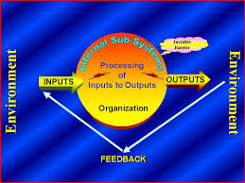
I. System approach applied to organization

Slide 19
I. System approach applied to organization
If a company has to change business processes or deploy new technology in order to stay competitive, then people, jobs descriptions and skill sets must also change or adjust. Such adjustments may affect the morale or general attitude of the organization. A system approach of organization methodology is applied to "smooth over" these issues as the organization goes through such changes
According to Dr H.L. Kaila, author of "Human Resource Management," the system approach of organization involves three basic steps: planning for change, assessing change forces and implementing the changes. In other words, management need a holistic approach. A system approach of organization methodology can also be referred to as a change management plan.

Slide 20
I. System approach applied to organization
Properly applied, a system approach of organization methodology can position a company to compete effectively in the global economy. Once the methodology or change management plan is in place, organizations can adapt quickly to change and more forward with minimum down time.
Inputs:
Men Material Machines Money Methods
Outputs:
Product Services
External Environment:
Social Political Cultural
Internal Environment:
Board of directors Employees Culture

Slide 21
II. Necessity of organization
The increasing size of the manufacturing plant, introduction of most complex methods of production, tough competition between the enterprise and labor problems has necessitated every factory to be well organized, in order to produce required quantity of the products of the required quality, at the required time with the minimum production cost.
“Take away all our money, great works, ore mines, and coke ovens but leave our organization and in few years. I shall have established myself. In fact the success and failures of any enterprise largely depends on the nature of organization.”
– A. Carngie, an American Industrialist

Slide 22
II. Necessity of organization
A good organization is therefore necessary for the following reasons:
Complexity of Industry
Growing competition
Optimum utilization of resources
Reduced labor problem
Fixation of authority and responsibility
Co-ordination and directing efforts
Facilitates Administration
Stimulates Creativity

Slide 23
III. Principle of organization
Some of the important principles to be followed for developing sound and efficient organization structure are:
Organizational structure - The way managers design their firms to achieve their organization’s mission and goals. The objectives must be clearly defined for the entire enterprise, for each department and even for each position in the organization structure. There must be unity of objectives so that all efforts can be concentrated on achieving the set goals- at minimum cost.
Division of Labor and Departmentalization
Division of labor - Degree to which tasks are subdivided into separate jobs.
Specialization can lead to efficiency and increased performance, but if jobs become too specialized and boring, performance can decrease.
Departmentalization – Grouping of related activities into units.

Slide 24
III. Principle of organization
Chain of Command
Line of authority from the top to the bottom of the organization.
Tells you who your boss is and who to go to for help.
To work quickly, employees at all levels need to communicate directly, and who the boss is can change according to the task to be performed.
Span of Management
It is the number of employees reporting to a manager.
The number of employees reporting to one manager affects the number of levels of managers.
With downsizing, the trend has clearly been to increase the span of management.

Slide 25
III. Principle of organization
Centralized and Decentralized Authority
With centralized authority, top managers make important decisions.
With decentralized authority, middle and first-line managers make important decisions where the action is.
Decentralization allows more input into decision making and greater employee commitment to carrying out the decisions.
Coordination
With the division of labor and departmentalization comes the need to coordinate the work of all departments.
Is difficult with wider spans of management and decentralization.

Slide 26
III. Principle of organization
Simplicity
The organization structure should be simple with minimum number of levels. If the organization structure has a large number of levels, the problem of effective co- ordination and communication may arise.
Flexibility
The organizational structure should be flexible enough to permit slight alternations and expansions whenever needed, due to changed circumstances.
Communication
Not only executive should pass down information to the subordinates , there should be feedback i.e., replies should come from those who receive information. For better results it should have free two-way communications.
These principles are not rigid and they must be used as per local circumstances.

Slide 27
IV. Formal and Informal Organizations
Formal Organizations
It refers to the organization structure deliberately created by management for achieving the objectives of enterprise. It is a network of official authority responsibility relationships and communication follows. It is an official and rational structure.
Definition :-:
According to Chester Bernard , “Formal organization is a system of consciously coordinated activities of two or more persons towards a common objectives. The essence of formal organization is conscious common purpose and formal organization comes into existence when persons
are able to communicate with each other
are willing to act and
share a purpose.”

Slide 28
IV. Formal and Informal Organizations
Informal organization
It refers to the pattern of activity interactions and human relationship which emerge spontaneously due to social and psychological forces operating at the work place. It arises naturally on the basis of friendship or some common interest which may or may not be related with work.
Definition :
According to Chester Bernard , “ Informal organization is joint personal activity with out conscious common purpose though contributing to joint result.”

Slide 29
IV. Formal and Informal Organizations
Origin: Formal organization is created deliberately and consciously by management. Informal organization emerges spontaneously on account of socio psychological forces operating at the work place.
Purpose: Formal organization is created for achieving the legitimate objective of the organization . Informal organization is created by the members of the organization for their social and psychological satisfaction.
Size: Formal group may be quite large in size. Informal groups tent to be small.

Slide 30
IV. Formal and Informal Organizations
Nature of group: Formal groups are stable and may continue for a very long period of time. Informal groups were quite unstable in nature.
Number of group: Generally the number of informal group is greater than the number of the formal group.
Authority: Formal organization is bound together by a hierarchical structure. In Informal organization all members are equal.

Slide 31
IV. Formal and Informal Organizations
Behavior of Members: In formal organization behavior of the members were governed by formal rules and regulations. In the informal organization the behavior of the members is governed by norms beliefs and value of the group.
Communication: In formal organization, communication normally flows through the prescribed chain of command. In informal organization communications pass through the informal channels.
Abolition: Management can abolish the formal groups at any time. Management has no control over informal groups which are the creation of natural desire of human beings to interact.

Slide 32
IV. Formal and Informal Organizations
Leadership: In informal organization, leadership is vested in managers. In informal organization, leadership is not associated with manager ship.
Status: There are sharp status differentials among the members of formal organization, which inhibit free interaction and socialization. In informal organization there may be social ranking among people but these do not prevent free interaction among people.

Slide 33
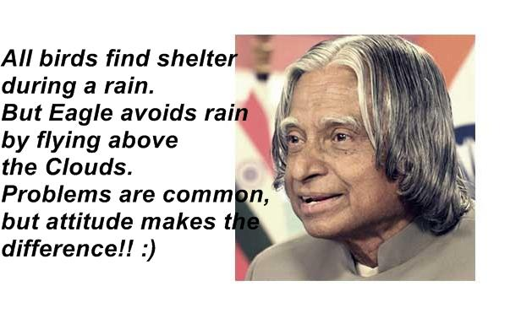
THANK YOU!!!

Slide 34
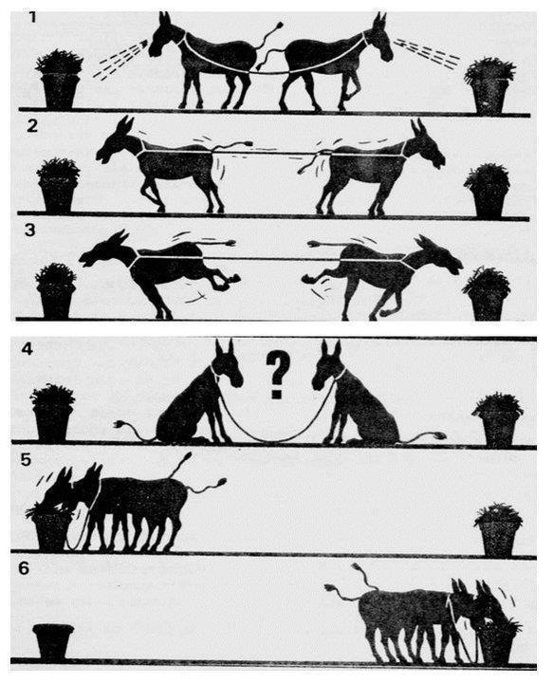
Management – course outline
Functions of Management
Levels of Management
Managerial Skills
Importance of Management
Models of Management
‘There are no underdeveloped countries, there are undermanaged countries.’

Slide 35
2. Management
Management may be defined as the planning, organizing, leading, and controlling of human and other resources to achieve organizational goals effectively and efficiently
- Resources include people, skills, know-how and experience, machinery, raw materials, computers and IT, patents, financial capital, and loyal customers and employees
- Goals include profit Levels or maximum cost levels, maintenance or growth of financial strength, quality standards, guest employee & management concerns, professional obligations, societal concerns
A precise definition of management can be stated as: “Management is a social process involving co-ordination of human and material resources through the functions of planning, organizing, staffing, leading and controlling in order to accomplish stated objectives.”

Slide 36
2. Management
Is management an art or science ?
ART: Because it depends on the skills, aptitude & creativity of the manager
SCIENCE: Because there is considerable knowledge in the field of management with basic principles for guidance of basic activities.
Management Process
Planning
Organizing
Coordinating
Staffing
Directing
Controlling
Evaluating
Revision in plans
Changes in procedures

Slide 37
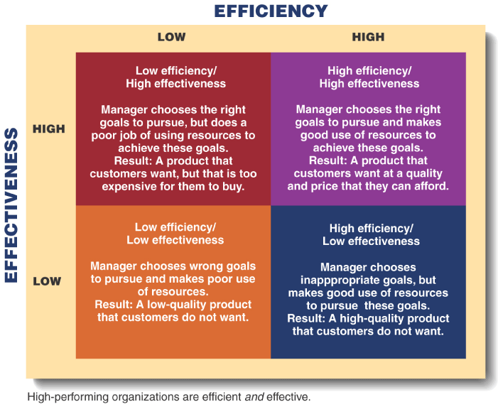
2. Management

Slide 38
Administration Vs Management
Administration: Concerned with laying down of corporate policy, obtaining finance, production & distribution.
Management: Concerned with actual execution of policies within limits set by administration.
Organization: Combines the work in such a way with individuals/groups that duties formed provide best possible application of available effort.

Slide 39
I. Functions of Management
Management is an ongoing activity consisting of number of functions. These are:
Planning
Organizing
Staffing
Directing
Motivating
Controlling
Co-ordinating
Communicating

Slide 40
A. Planning
Planning is the most basic of all management functions. Planning means thinking before doing. In other words, planning is the preparation for action.
Planning includes forecasting, formulation of objectives, policies, programs, schedules, procedures and budget.
“Planning is deciding in advance what to do, how to do it, when to do it and who is to do it. Planning bridges the gap from where we are, to where we want to go. It makes it possible for things to occur which would not otherwise happen” - Koontz and O’Donnell

Slide 41
A. Planning
Objectives of Planning
To help in effective forecasting.
To provide certainty in the activities.
To provide performance standards.
To give a specific direction to the organization.
To help in tuning organization with the environment.
To provide economy in the management.

Slide 42
A. Planning
Steps in Planning
Determination of objectives.
Establish planning premises and constraints.
Decide the planning period.
Collection, classification and processing of information.
Deciding alternative courses of action.
Evaluation of alternative.
Selection of best plan.
Subsidiary plans to aid master plan.
Controlling plans.

Slide 43
A. Planning
Advantages of Planning
Maximum utilization of resources.
Reduces uncertainty.
Basis for managerial action.
Basis for control.
Encourages innovation and creativity.
Limitations of Planning
Limitations of forecast.
Costly affair.
Influence of external factors.
Resistance to change.
Rigidity and inflexibility.

Slide 44
A. Planning
Elements/Components of Planning
Goals: relatively long run targets.
Objectives: ends towards which the activities of an organization are targeted.
Policies: provides the framework for executive action.
Rules: simplest type of plan chosen from alternatives.
Procedures: means of implementing a policy.
Programs: step by step approach to guide action.
Schedule: when each of series of action should take place.
Budget: projection defining anticipated costs.

Slide 45
B. Organizing
Organizing involves identification and grouping the activities to be performed and dividing them among the individuals and creating authority and responsibility, relationship among them. Organization, in fact is a back bone of management, which establishes relationship between people, work and resources.
Steps in Organizing
Determination of activities.
Division of activities.
Fitting individuals into jobs.
Developing relationships in terms of authorities and responsibilities.

Slide 46
C. Staffing
Staffing involves filling the positions needed in the organization structure by appointing competent and qualified persons for the jobs.
Steps in Staffing
Recruitment
Selection
Placement
Training
Development of personnel
Developing system for remuneration of personnel and evaluating their performance.

Slide 47
D. Directing
Directing involves motivating, guiding and supervising subordinates towards company objectives. Only giving orders is not directing. Good planning may ensure the achievement of the predetermined objectives only when the human efforts, largely diverse are co-ordinated, guided and directed for the accomplishment of the objectives.
Directing is that part of the management process which actuates the organizational members to work effectively and efficiently for the attainment of organizational objectives.
Steps in Directing
Issue of orders and instructions.
Guidance and training of subordinates.
Supervision of subordinates’ work.

Slide 48
E. Motivating
Motivation means inspiring people to intensify their desire and willingness to perform their duties effectively and co-operate for the achievement of common objectives of the business.
“Motivation is the act of stimulating some one or oneself to get a desired course of action, to push the right button to get desired action.”
Fundamentals of Motivation
The first fundamental thing is that a person wants to exist and survive and for this he needs basic necessities of life e.g. food, cloth, shelter, education and medical aid etc.
The second fundamental of motivation is the desire to achieve a goal, for satisfaction or bliss. Basically, people are motivated to put in sincere efforts if they are assured of fulfilling their needs. Such as psychological needs, social needs, security needs, ego (needs for self-respect) etc.

Slide 49
E. Motivating
Classification of Motivation
Internal Motivation: E.g. Interests, emotional attachments, burning desires, fighting spirits for noble cause etc.
External Motivation: E.g. Attractive salary, bonus, praise, incentive, punishment, fear of loss of job etc.
Essentials of Sound Motivation System
Good wages.
Good financial incentive scheme.
Opportunities for achievement, growth, motivation.
Human relations.
Good working conditions.
Job satisfaction.
Job security.

Slide 50
F. Controlling
It management literature, the word “Control” has a special meaning. It means setting standards, measuring actual performance, and taking corrective action.
“Controlling implies measurements of accomplishment against the standard and the correction of deviations to ensure attainment of objectives according to plans.” - Koontz and O’Donell
Steps in Controlling
Setting standards.
Checking and reporting on performance.
Taking corrective action.
Types of Control: based on objectives
Physical Control: quantity and quality of products
Financial Control: cost per unit production, cost of material, labor expenses etc.
Budgetary Control: physical and financial standards for future are determined and results are compared against these pre-determined standards.

Slide 51
G. Co-ordinating
Co-ordination may be defined as on-going process whereby a manager develops an integrated, orderly and synchronized pattern of group effort among his subordinates and tries to attain unity of effort in the pursuit of a common purpose.
“Co-ordination is the orderly management of group effort, to provide unity of action in the pursuit of common purpose” – Alan C. Reiley and James D. Mooney
Types of Co-ordination
Internal Co-ordination
External Co-ordination
Vertical Co-ordination
Horizontal Co-ordination

Slide 52
H. Communicating
Communication is the process by which instructions, ideas, thoughts or information are transmitted, received and understand, by the persons working in organization.
Components of Communication
Sender
Message
Receiver
Feedback
The sender must appropriately prepare the message to be transmitted to the receiver. The receiver must understand the message clearly. Communication is never complete until the sender knows that the message has been received and understood either through feedback or observation of the receiver’s behavior.

Slide 53
H. Communicating
Process of Effective Communication
For every communication, at least two persons are required i.e. a sender and a receiver. The various steps involved in communication are as given in the communication model as shown below.
Figure: Process of Effective Communication
Idea Creation
Encoding
Transmission
Feedback
Action
Decoding
Receiving

Slide 54
II. Levels of Management
Top Level Management
Middle Level Management
Lower Level Management

Slide 55
II. Levels of Management
Top level Management:
Responsible for the performance of all departments and have cross-departmental responsibility.
Establish organizational goals and monitor middle managers
Decide how different departments should interact
Ultimately responsible for the success or failure of an organization
Includes Board of Directors, CEO, Chairman, Officer etc.

Slide 56
II. Levels of Management
Middle level Management:
Responsible for finding the best way to organize human and other resources to achieve organizational goals
Establish organizational goals and monitor middle managers
Includes Head of Department, Section officer etc.
Lower level Management:
Responsible for daily supervision of the non-managerial employees who perform many of the specific activities necessary to produce goods and services.
Includes Foreman, Supervisor, Inspector, Superintendent, Workers

Slide 57
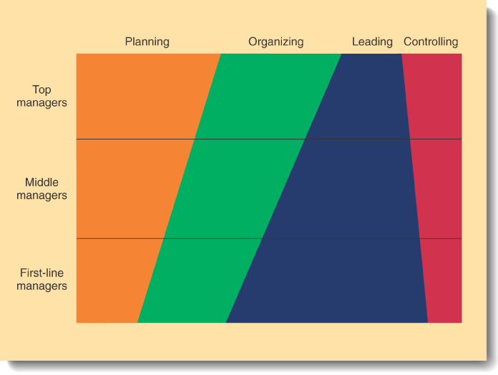
II. Levels of Management
Relative Amount of Time That Managers Spend on the Four Managerial Functions

Slide 58
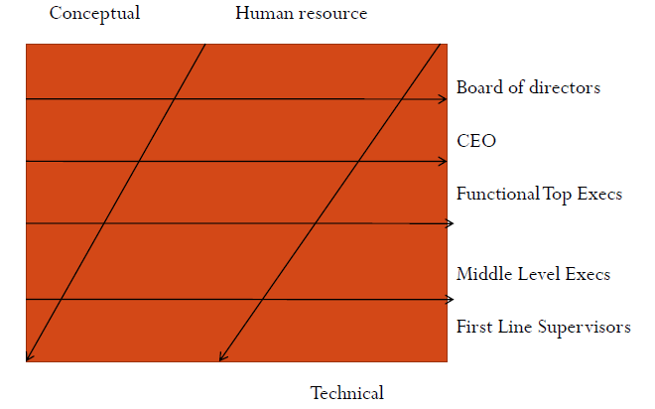
II. Levels of Management

Slide 59
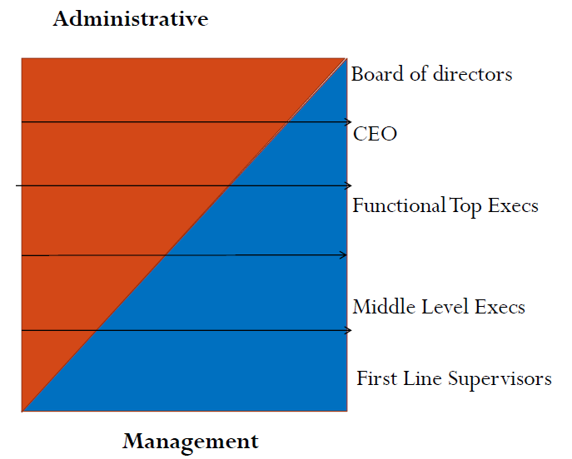
II. Levels of Management

Slide 60
III. Managerial Skills
Managerial skills is the ability of a manager to make a smooth functioning team of people working under him. It involves obligation to make effective utilization of human and material resources. It requires sound judgment to handle complex situations.
The skills required of a successful manager, whether he is working in a business organization, an educational institute or a hospital can be classified as under:
Technical Skills
Conceptual Skills
Human Relation Skills

Slide 61
III. Managerial Skills
Conceptual skills: The ability to analyze and diagnose a situation and distinguish between cause and effect.
- Decision making skills: ability to take timely and accurate decisions.
- Organizational skills: ability to place right men for the right job.
Human skills: The ability to understand, alter, lead, and control the behavior of other individuals and groups.
- Communicating skills: ability to pass on information.
- Motivating skills: ability to inspire the subordinates.
- Leadership skills: ability to inspire confidence and trust in the sub-ordinates.
Technical skills: Job-specific skills required to perform a particular type of work or occupation at a high level.
- ability to use methods, processes, tools, equipment, techniques and knowledge of a specialized field.

Slide 62
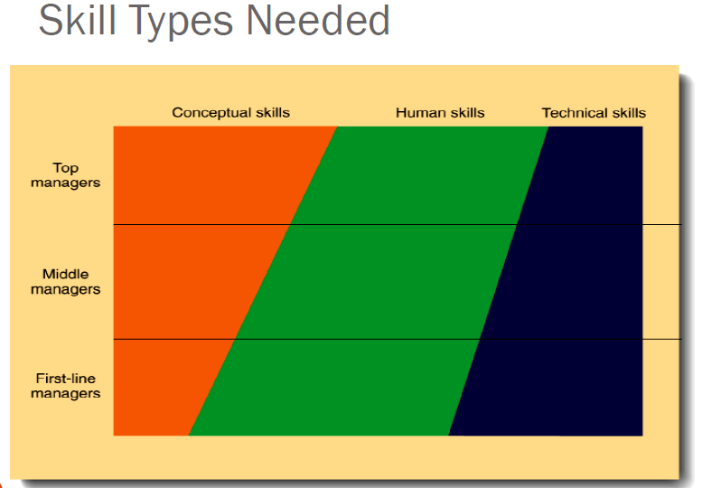
III. Managerial Skills

Slide 63
IV. Importance of Management
The more efficient and effective use of scarce resources that organizations make of those resources, the greater the relative well-being and prosperity of people in that society.
Helps people deal with their bosses and coworkers.
Opens a path to a well-paying job and a satisfying career

Slide 64
V. Models of Management
Based on the different practices, there are seven different models of management.
Hierarchical management Model
Task oriented management model
Allocational management model
Transactional management model
Team effort management model
Knowledge oriented management model
Goal concentrates management model

Slide 65
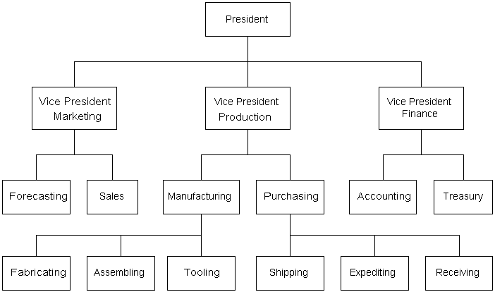
V. Models of Management
Hierarchical Management Model
Emphasizes responsibility and authority.
Managers receives authority from superior to control the work of sub-ordinates in return of responsibility.
Limitations: It cannot explain leadership or role of charisma & it does not account for information connections & communications.

Slide 66
V. Models of Management
Planning
Task oriented management model
Managers performs 5 major tasks (planning, organizing, coordinating, directing and controlling.
The process is not linear and can have cycles and can create arbitrary and possesses artificial links between managers and workers.
Controlling
Organizing
Directing
Co-ordinating

Slide 67
V. Models of Management
Allocational management model
A resource manager obtains, allocates, shares, monitors consumption and return resources keeping the ‘cup topped up’ as necessary.
It does not provide a true process view of management.
It distinguishes among the type of resources and stages of resources and recognizes the nature of the organization.

Slide 68
V. Models of Management
Transactional management model
It views management as a stage in value added chains of organizational efforts.
It stress the role in adding value to the raw resources, an organization uses to produce it products or services.
It closely examines the process through which management adds value.
It sees management as integral to the organization rather than just a control.

Slide 69

V. Models of Management
Team effort management model
Managers are concerned with group development and functioning.
As team leaders, managers are expected to embody the typical characteristics of group in order to motivate the group.
Complex set of interlocking teams in which managers concentrates on co-operation, leadership and coordination.

Slide 70
V. Models of Management
Knowledge oriented management model
Concentrates on the development and use of management knowledge.
Management develops knowledge and this knowledge is diffused to the monitoring relationship, teaching, coaching and active training.
Advantages: Organization must learn to adapt and win in changing environment.
?

Slide 71
V. Models of Management
Goal concentrates management model
Focuses on role management and goals in actions.
Views management as a control function, incorporates resource management.
Managers receive information from internal and external environment & order adjustments so that an original plan can be adhered to goals in actions.

Slide 72
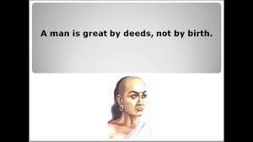
THANK YOU!!!

Slide 73
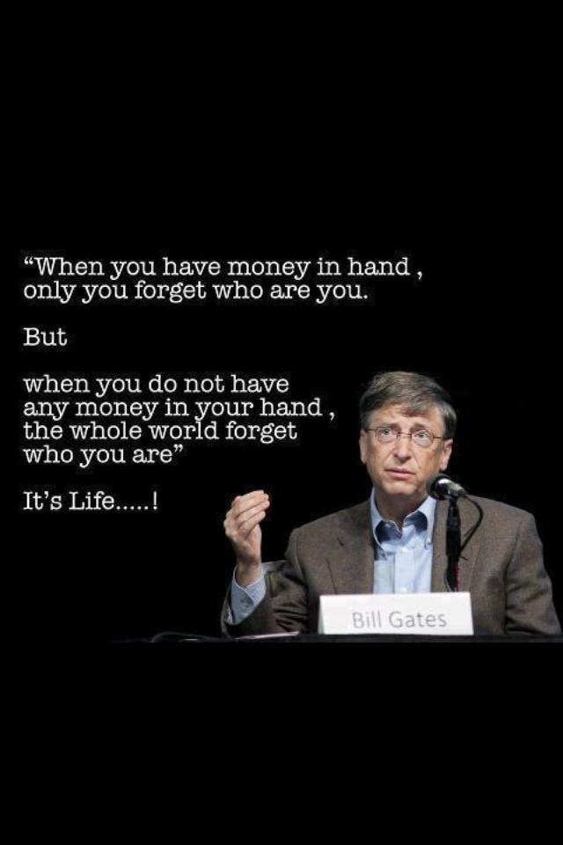
3. Theory of management – course outline
Scientific Management Approach
Administrative Management
Approach
Behavioral Management Approach
Modern Management Theories

Slide 74
3. Theory of Management
Management can be divided into following categories based on the approaches.
Scientific Management Approach
Administrative Management Approach
Behavioral Management Approach
Modern Management Theories

Slide 75
I. Scientific Management Approach
As a term Scientific Management was first used in USA in 1910 by Louis Brandies. As a process, it was first visualized in UK in 1832 by Charles Babbage.
The utility of scientific methods to problems of management was first of all introduced by F.W. Taylor in America (1865-1915). He is regarded as a “Father of Scientific Management”.
Scientific management may be defined as ‘art of knowing exactly what is to be done and the best way of doing it”.

Slide 76
I. Scientific Management Approach
It is the result of applying scientific knowledge and the scientific methods to the various aspects of management and the problems that arise from them. It tries to make the best use of production resources (men, materials, machines, capital etc.)
Principles of Scientific Management
Development of science for each element of work.
Scientific selection, placement and training of workers.
Division of labor.

Slide 77
I. Scientific Management Approach
Principles of Scientific Management (contd…)
iii. Standardization of methods, procedures, tools and equipment.
iv. Use of time and motion study.
v. Differential wage system.
vi. Co-operation between labor and management.
vii. Principle of management by exception.

Slide 78
II. Administrative Management Approach
Administrative theory of management was initiated by H. Fayol, a French engineer-cum-manager in Europe and his followers contributed a lot to the administrative theory of management.
H. Fayol is known as a “Father of Modern Management”.
He established the pattern of management and the pyramidal form of organization. He pointed out the technical ability is more dominating on the lower level of management whereas managerial ability is more important on the higher level of management.

Slide 79
II. Administrative Management Approach
Fayol analyzed the process of management and divided the activities of an industrial undertaking six groups:
Technical activities (production, manufacture, adaptation)
Commercial activities (purchasing, selling and exchange)
Financial activities (optimum use of capital)
Security (protection of property and persons)
Accounting (stock taking, balance sheet, costing, statistics)
Managerial (planning, organizing, commanding, co-ordinating and controlling)

Slide 80
II. Administrative Management Approach
Principles of Administrative management theory
Division of work
Authority and responsibility
Discipline
Unity of command
Unity of Direction
Emphasis on subordination of personal interests to general or common interest.
Adequate remuneration to personnel.

Slide 81
II. Administrative Management Approach
Principles of Administrative management theory
viii. Centralization.
ix. Scaler chain or line of authority.
x. Order
xi. Equity
xii. Stability of workers
xiii. Initiative.
xiv. Team spirit.

Slide 82
II. Administrative Management Approach
Contribution of Frank Gilbreth (father of motion study)
He introduced process chart and concluded that fatigue can be reduced considerably by allowing rest periods, planning seating arrangement, improving working conditions and by using principles of motion economy.
Contribution of Gantt
He developed a Gantt chart which is still used as a scheduling technique to have a immediate comparison between the planned work and the actual progress of the work. So as to enable the management to take corrective action if there is a significant deviation.

Slide 83
III. Behavioral Management Approach
Scientific management theory concentrated on physical resources rather than human resources. Prof. Elton Mayo has stated that an organization is essentially a social system and not merely techno-economic system.
Knowledge of human nature can solve many problems of management.
He stressed that successful human relations approach can easily create harmony in an organization, higher employee satisfaction and therefore higher operational efficiency and productivity.

Slide 84
III. Behavioral Management Approach
A.H. Maslow developed a need hierarchy to explain human behavior within an organization. The knowledge of individual and group behavior enables to develop suitable work atmosphere or situations which can increase productivity as well as employee satisfaction.
Behavioral approaches have clearly pointed out that job conditions and the job itself are the motivators that can satisfy the needs of both employees and the organization.
These motivators are recognition, sense of belonging, challenging job, independence, participation achievement, enlargement and enrichment of job itself.

Slide 85
III. Behavioral Management Approach
Elements of Behavioral Theory
The Individual: This theory stressed that individual difference must be recognized. Each individual has feelings, emotions, perception and attitudes; and ever changing psychology.
Work Group: The management must recognize the importance of informal organization (work group) and it must be integrated intelligently with formal organization. This theory recognizes the vital effect of group psychology and behavior on motivation and productivity.
Participative management: This theory advocated worker participation in management. It allows labor to participate in decision making and problem solving primarily to increase productivity.

Slide 86
IV. Modern Management Theories
Modern management theories started after 1950. There are four streams under the modern management theory:
Quantitative approach to management.
System approach to management.
Contingency approach to management.
Operational approach to management.

Slide 87
i) Quantitative approach to management
The scientific approach of Taylor could be classified as an early form of quantitative approach to management.
The basic approach is the construction of a quantitative model. The construction of the model expresses the effectiveness of the system under study as a function of a set of variables at least one of which is subject to control.
Essential features of quantitative approach:
Management must make use of mathematical tools and techniques (e.g.. Use of equations) for problem solving.
Operational research, mathematical tools, simulation and model building are the basic methodologies developed by this approach. It has helped the management in systematizing thinking.

Slide 88
ii) System approach to management
The system approach is the recent contribution to management thought developed in the late 1960s.
The prominent contributors to this approach are Kenneth, Boulding, Johnson, Rosen Zweig and Churchman. In relation to organization, system is defined as, ‘an established arrangement of components which leads to accomplishment of particular objectives as per plan’.
PLAN
Objectives
Policies
Procedures
Programs
Schedules
Methods
INPUTS
Information (Technology)
Energy (motive power)
Materials or Goods
PROCESS
Conversion of inputs to outputs
(Men-Machine system)
OUTPUT
Information (for consulting firm)
Energy (for power generation comp.)
Materials (products)

Slide 89
iii) Contingency approach to management
The major contributors to this thought are Joan Woodward, Fiedler, Lorsch and Lawrence. The contingency approach to management is based upon the fact there is no one best way to handle any of the managerial problems.
The application of management principles and practices should be appropriate to specific situations (existing circumstances) in order to achieve best possible result. Process, behavioral, quantitative and systems tools of management should be applied situationally.
There are three major parts of the overall conceptual framework for contingency management:
Environment.
Management concepts, principles and techniques.
Contingent relationship between a) and b) above

Slide 90
iv) Operational approach to management
Knootz, O’Donnell and Weihrich eminent writers of management have adopted the operational approach to management.
The operational approach regards management as a universally applicable body of knowledge that can be brought to bear all the levels of managing and in all types of enterprises.
The approach further recognizes that the actual problems which mangers face and the environment in which they operate may vary between different enterprises and levels and it also recognizes that the application of science by a perspective practioner must take this into account in drawing and designing practical problem.

Slide 91
Characteristics of modern management thought
The system approach.
Dynamic nature.
Multi-disciplinary.
Multivariable in thought.
Multi-motivated in action.
Multi-level and Multi-dimensional.
Adaptive
It is probabilistic in approach.

Slide 92
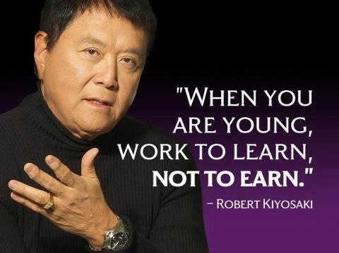
THANK YOU!!!

Slide 93
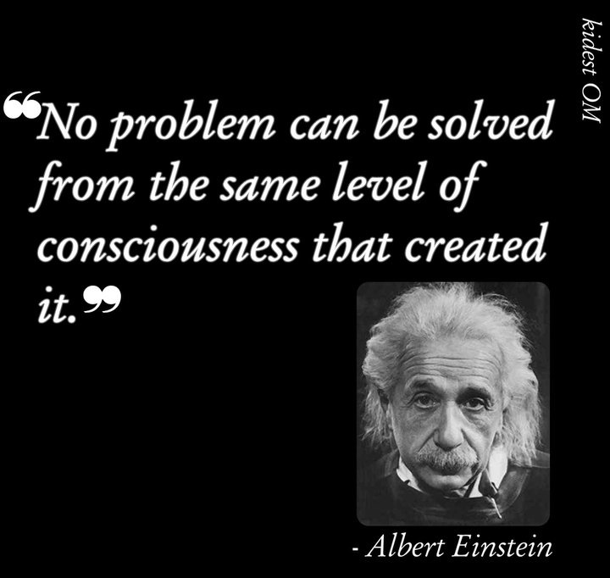
4. Forms of Ownership – course outline
Single Ownership
– Advantages and limitations
Partnership
– Types of Partners
– Advantages and limitations
Joint Stock Company
– Formation of Joint Stock Company
– Advantages and limitations
Co – operative Societies
– Types of Co – operatives
– Advantages and limitations
Public Corporations
– Advantages and limitations

Slide 94
4. Forms of Ownership
A firm is an ownership organization which combines the factors of production (men, materials, and machines) in a plant for the purpose of producing goods or services and selling them at profit.
The types of ownership selected depends upon the following factors:
Size and nature of the business to be started.
Technical difficulties.
Market competition and scope of the articles in the market.
Capital required to start the business and means to collect funds.
Limitations and restrictions put forth by the Govt. in connection with grant of loans, foreign exchange and such other things.

Slide 95
4. Forms of Ownership
The different forms of ownership found in practice are illustrated below:
Single Ownership
Partnership
Joint Stock Company
Co – operative Societies
Public Corporations

Slide 96
4. Forms of Ownership
Evaluation Criteria
Tax consideration
Liability exposure
Start-up and future capital requirement
Control
Managerial ability
Business goals
Management succession plans
Cost of formation

Slide 97

I. Single Ownership
It is the simplest and oldest form of organization.
A business owned and managed by one individual; the business and the owner are one and the same in the eyes of the law.
This form of ownership is most satisfactory in small scale industries, agriculture, cottage industries, commercial shops, handicrafts etc.

Slide 98
I. Single Ownership
Advantages
Simple to create
Better labor relationship.
Least costly form
Profit incentive
Total decision-making
No special legal restrictions
Easy to discontinue
Flexibility
Quality production

Slide 99
I. Single Ownership
Limitations
Unlimited personal liability
Limited skills and abilities
Feelings of isolation
Limited access to capital
Lack of continuity of business
Small income and short life
Cannot compete with a big business

Slide 100
II. Partnership
A person may posses exceptional business ability, experience, talent but no capital, he can have a financing partner.
A financier may need a managerial expert as well as a technical expert and all of them may combine to set up a business with common ownership and management by mutual agreement to form a partnership business.
An association of two or more people who co-own a business for the purpose of making a profit

Slide 101
II. Partnership
Types of Partners
General partners: partners who participate in the working of the firm and are responsible jointly with other partners, for all liabilities, obligations and defects of the firm are the general partners.
Limited partners: the liability for debts of the limited partners is limited to the extent of their contributed capital. They are not entitled to interfere in the administration of the firm.
Active or managing partners: who take active part in the management and formulation of policies. Sometimes they get salaries in addition to the normal profits as partners

Slide 102
II. Partnership
Types of Partners
Sleeping and silent partners: they simply contribute their capital in the business and get their share in the profit of the firm. They are liable for all liabilities of the firm as partners.
Nominal partners: they lend their reputed name for the company’s reputation. They do not invest money and do not take active part in the management.
Minor partners: those whose age is below 18.

Slide 103
II. Partnership
Advantages
Easy to establish
Complementary skills
Division of profits
Larger pool of capital
Ability to attract limited partners
Little governmental regulation
Flexibility
Taxation
Prompt decisions
Divisions of labor

Slide 104
II. Partnership
Disadvantages
Unlimited liability of at least one
Difficulty in disposing of interest
Lack of continuity
Potential for personality and authority conflicts
Partners bound by law of agency
Less secrecy
Short life

Slide 105
III. Joint Stock Company
In this type, capital is contributed by a large number of persons, in the form of shares of different values. Persons who purchase the shares are called shareholders, and the managing body known as “Board of Directors” is elected by the shareholders. The shares are transferable.
Characteristics of Joint Stock Company
Created by registering under the company act.
Separate legal existence.
Perpetual life and stable.
Common seal.
Limited liability.
Types of Joint Stock Company
Private limited company: Max. number of shareholders 50 generally within friends and relatives where transfer of shares is limited to members only.
Public limited company: Min. number required is 7 and offers shares to general public. Shares are transferable without any prior approval.

Slide 106
III. Joint Stock Company
Formation of Joint Stock Company.
An entrepreneur (promoter) prepares a scheme of business, he secures the co-operation of at least six more persons, because the maximum number of persons to form a company is seven. The promoters of the company prepare the following documents.
Memorandum of association.
Articles of association.
A list of persons who have consented to be the Directors of the company along with the consent in writing of such persons.
A declaration by an advocate to the effect that all the requirements of the Act have been fulfilled.
Name and address of promoters

Slide 107
III. Joint Stock Company
Advantages
Limited liability.
Huge capital.
Economies of large scale.
Democratic.
Permanent existence.
Legal control.
Share transferable.
Disadvantages
Exploit shareholders.
Legal complexities.
Delay in decisions.
Favourisms.
Difficult labor relations

Slide 108
IV. Co-operative Societies
Co-operative societies is a form of organization where in persons irrespective of caste, creed, and religion, voluntarily associate together as human beings on the basis of equality for the fulfillment of their common economic interests.
Co-operative spirit is the heart of a co-operative society. “Each shall work for all and all for each” is the motto of co-operation.
Characteristics:
Voluntary organization.
Open membership.
Economic and Democratic management.
Profit is not important.
Spirit of Co-operation.
Unity.
Common Interest.
Co-operative status.

Slide 109
IV. Co-operative Societies
Types of Co-operative societies
Producers co-operative society: the workers wish to be their own masters the business owned by them. E.g. agricultural and cottage industries.
Consumers co-operative society: a store is opened in which articles of common use are stocked and sold at reasonable prices.
Housing co-operative society: they are formed for the purpose of getting plots or constructing houses for the needy persons. Government provides facilities for this purpose.
Credit co-operative society: its objective is to finance the poor cultivators by providing loans at low rate of interest for the development of land, purchase of agricultural machinery, fertilizers etc.

Slide 110
IV. Co-operative Societies
Advantages
Protect interests of weak people.
Elimination of middle man.
Services motive.
Democratic nature.
Sense of co-operation.
Disadvantages
Lack of co-ordination.
Chances of undue advantages.
Favourism.
Limited capital.
Inefficient management.
Political influence.

Slide 111

V. Public Corporations
A separate legal entity apart from its owners which receives the right to exist from the state in which in which it is incorporated.
Domestic
Foreign
Alien
Publicly held
Closely held

Slide 112
V. Public Corporations
Certificate of Incorporation
Name
Statement of purpose
Time horizon
Names and addresses of incorporators
Place of business
Capital stock authorization’
Capital required at time of incorporation
Provisions for preemptive rights
Restrictions on transferring shares
Names and addresses of officers
By-laws

Slide 113
V. Public Corporations
Advantages
Limited liability of stockholders
Ability to attract capital
Ability to continue indefinitely
Transferable ownership

Slide 114
V. Public Corporations
Disadvantages
Cost and time in incorporating
Double taxation
Potential for diminished incentives
Legal requirements and red tape
Potential loss of control

Slide 115
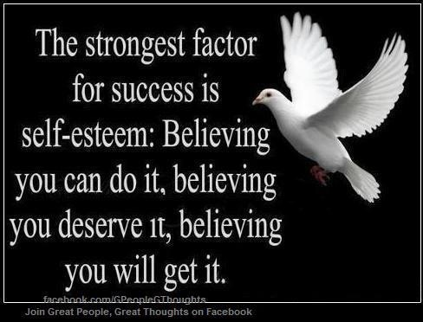
THANK YOU!!!

Slide 116

Organizational Structure – course outline
Line Organization
– Advantages and disadvantages
Functional Organization
– Advantages and disadvantages
Line and Staff Organization
– Advantages and disadvantages
Committee Organization
– Advantages and disadvantages

Slide 117
5. Organizational Structure
The organization structure is a skeleton or a framework that divides the total activities into related groups, develops superior and subordinate relationship among the persons by prescribing the authorities.
Thus, it indicates the hierarchy (persons arranged according to rank), authority structure and reporting relationships (who should report to whom).
The organizational structure differs from industry to industry. It usually depends upon:
Size of the organization.
Nature of the product being manufactured.
Complexity of the problems being faced.

Slide 118
I. Line Organization
This is the simplest and earliest type of organization. It is also called as Military or Scalar organization.
In this type of organization, the line of authority flows directly from top to bottom and the line of responsibility from bottom to top in opposite direction.
In line organization, the business activities are divided into three groups:
Finance or accounts
Production
Sales (distribution)

Slide 119
I. Line Organization
Each of these departments is subdivided into certain self-contained departments or sections.
Each departmental head has complete control over his section and he is fully authorized to select his labor, staff, purchases of raw materials, stores and to set the standards of output etc.
The responsibility of each departmental head is clearly defined. Each department works as a self-supporting unit.

Slide 120
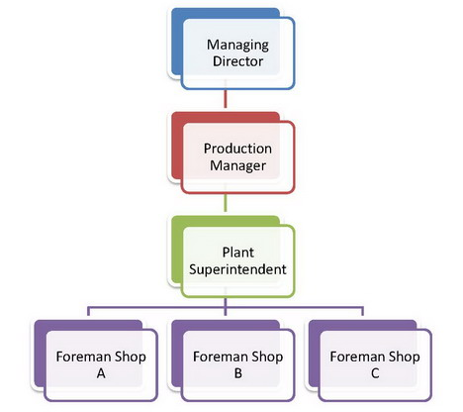
I. Line Organization

Slide 121
I. Line Organization
Advantages
Simplicity.
Clear cut authority and responsibility.
Strong in discipline.
Unity of command.
Quick decisions.
Rapid communication.
Co-ordination.
Development of all-round activities.
Disadvantages
Undue reliance.
Personal limitation.
Overload of work.
Dictatorial way.
Duplication of work.
Unsuitable for large concerns.
Scope of favourism.
Wastage of materials and man hours.

Slide 122
II. Functional Organization
F.W. Taylor suggested functional organization, because it was difficult to find all-round persons qualified to work at middle management levels in the line organization.
Functional organization divides managerial activities, so that each head from the works manager down has few functions to perform as possible and is able to become specialist in these. Authority from top to down is delegated according to the function.
In this type of organization specialists like production engineer, design engineer, maintenance engineer, purchase officer etc. are employed.

Slide 123
II. Functional Organization
Each specialist is supposed to give his functional advice to all other foreman and workers.
Taylor divided the responsibility of shop supervision among several foreman, each specially qualified and in charge of certain aspect of work.
Each specialist is authorized to give orders to workers, but only in regard of his field of specialization.

Slide 124
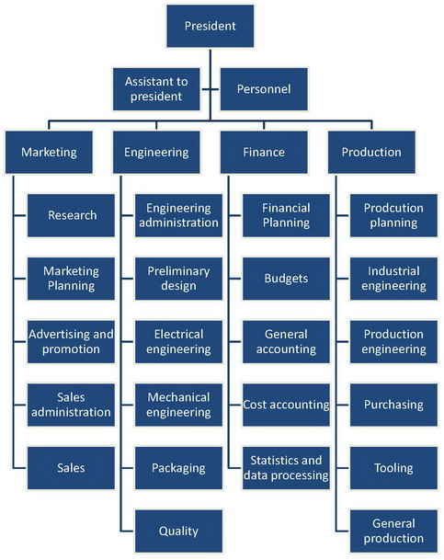
II. Functional Organization

Slide 125
II. Functional Organization
Advantages
Separation of work.
Specialization.
Narrow range with high depth.
Ease in selection and training.
Reduction in prime cost.
Scope for growth and development of business.
Standardized operations.
Standardization.
Disadvantages
Indiscipline.
Shifting of responsibility.
Kills the initiative of workers.
Overlapping of authority.
Lack of co-ordination between functions.
Increase in cost.

Slide 126
III. Line and Staff Organization
Line and staff organization is that in which the line heads are assisted by specialist staff.
If the firm is too large, managers cannot give careful attention to every aspect of management. They are busy with ordinary task of production and selling.
Hence staff is deputed to do the work of investigation, research, recording and advising to managers. Thus the staff brings specialization by assisting the line officers.

Slide 127
III. Line and Staff Organization
The line maintains discipline and stability, staff provided experts information and helps to improve overall efficiency. Thus the staff are thinkers while the line are doers.
Usually the staff has no administrative authority. They serve only in advisory capacity in their field of specialization.
In big steel plants, heavy electrical electricity boards, large manufacturing plants etc.

Slide 128
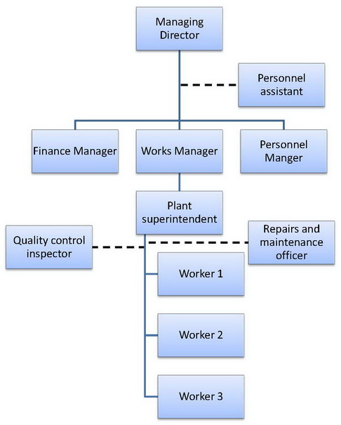
III. Line and Staff Organization

Slide 129
III. Line and Staff Organization
Advantages
Planned specialization.
Well defined authority and responsibility.
Availability of specialized knowledge.
Adaptability to progressive business.
Less wastage.
Improved quality.
Disadvantages
Chances of mis-interpretation.
Chances of friction.
Ineffective staff in the absence of authority.
Expensive
Lethargic staff officer in the absence of accountability.
Loss of initiative by line executive

Slide 130
IV. Committee Organization
Committees have come to be recognized as a formal part of organization structure and they are found at all levels of management hierarchy in all large companies. Thus committees are not separate type organizations.
A committee is a formally organized group of individuals formed for the purpose of giving advice on certain important problems, which cannot usually be solved by an individual.

Slide 131
IV. Committee Organization
The committee members meet repeatedly, discuss, decide and recommend solution to certain problems of the organization.
The committees may be of different types as follows:
Ad-hoc committee: formed temporarily for some specific temporary function only.
Permanent committee: formed when the nature of work is of repetitive type. E.g. research committee, purchase committee etc.

Slide 132
IV. Committee Organization
Advantages
Problem is looked from more than one point of view.
Co-ordination.
Helps to adopt new ideas, innovations.
Promotes united actions.
Democratic and participative management.
Disadvantages
Delay in decision making.
Compromise.
Non-uniformity in final decision.
Costly structure.

Slide 133

THANK YOU!!!

Slide 134
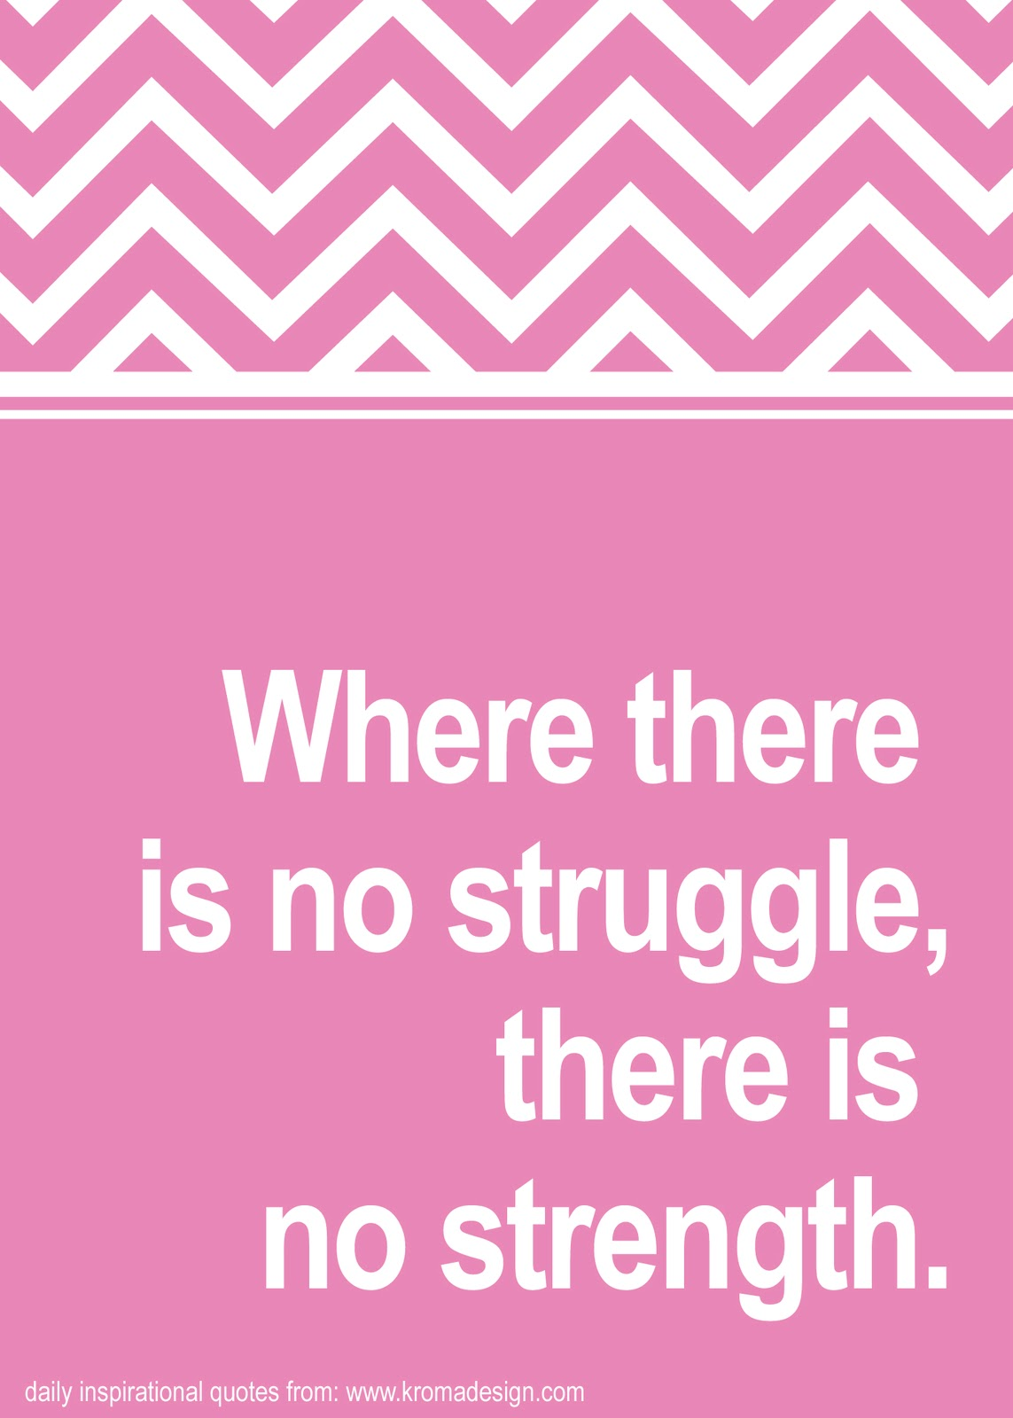
Purchasing and Marketing Management – course outline
Purchasing – Introduction
Functions of Purchasing Department
Methods of Purchasing
Marketing – Introduction
Functions of Marketing
Advertising

Slide 135
I. Purchasing- Introduction
Purchasing is the first phase of materials management.
Procurement is a function responsible for getting the materials, supplies and equipments of right quality, in the right quantities from the right source, at the right prices and at the right time popularly known as the five R’s of the art of efficient purchasing.
‘Purchasing is the procuring of materials, supplies, machines, tools and services required for equipment, maintenance and operation of a manufacturing plant.’ – Alford and Beatty.

Slide 136
I. Purchasing- Introduction
In a manufacturing firm the purchases can be classified as raw materials, components, consumable stores and supplies, office supplies, spares and tools, machines and equipment.
Duties, functions and responsibilities of purchase department differ from industry to industry. Broadly, they can be stated as below:
Maintain records of materials indicating materials that can be used as substitute.
Maintain records of reliable source of supply and prices for each type of material required in the organization.

Slide 137
II. Functions of Purchasing Department
3. Review material specifications with a view to simplifying and standardizing them.
Calling quotations.
Analyze quotations and making contacts with right sources of supply.
Placing order and necessary follow up of supplies.
Maintain records of all purchases.
To make sure through inspection that right quality of material in right quantity has been purchased.
Checking and approving choices.

Slide 138
II. Functions of Purchasing Department
10. Checking requisitions.
11. To prepare purchase budget.
12. To ensure that the material is purchased at right time and at economical rates.
13. To prepare up-to-date list of materials required for different departments/sections.
14. To maintain uninterrupted supply of materials to various production sections.
15. To act as liaison between the vendors and different departments of the concern such as production, quality control, finance, maintenance etc.

Slide 139
II. Functions of Purchasing Department
16. To ensure prompt payment to vendors. This will help to improve vendor-vendee relations and increase in reputation of the firm.
17. To handle sub-contracts at the time of high business activity.
18. Develop new sources of supply.
19. To maintain inventory at optimum level.
20. To take decision about disposal of salvage and a scrap.

Slide 140
III. Methods of Purchasing
The materials, parts, tools, equipment, supplies etc. required in the industry are purchased by different methods.
Depending upon the size of the industry, nature of the material and quantity of the materials required, the different methods of purchasing are:
Purchasing by requirements: This method is also called as ‘hand-to-mouth buying’. In this method materials are purchased whenever the need arises.

Slide 141
III. Methods of Purchasing
2. Purchasing for specified period: In this method the standard materials like oils, coolants, stationary and other materials required regularly for the operation and maintenance of the plants, offices and other departments are purchased in quantities sufficient for specific future period, production schedules are usually the controlling factors in determination of the period.
3. Market purchasing: This method takes the full advantages of prevailing market conditions and price fluctuations. The material requirements based on production planning are calculated and market trends are analyzed before making purchases. The materials are purchased in advance of future need when the prices are low and likely to rise in future.

Slide 142
III. Methods of Purchasing
4. Speculative purchasing: It is an attempt to gain considerable profit by buying an excess of materials when prices are considered to be at low point. Unlike market purchasing, it makes price trends the primary factor in buying and gives less regard to the strict material requirements of the business.
5. Rate contract purchasing: In this method, contracts are given to suppliers to supply the material at agreed prices for a certain period (say 2-3 years). The contract is subjected to review with an appropriate period of notice. Many concerns dealing in large quantities of basic materials like pig iron, steel, coal, coke etc. prefer to supply the materials on the contract basis over a period of time.

Slide 143
III. Methods of Purchasing
6. Group purchasing: In this method, the materials are purchased in groups or lots in one order instead of placing separate orders for each item.
7. Purchasing through Directorate General of supplies and disposal: This department enters into contract with various firms for supply of certain materials to government departments during the year at agreed rates. These firms have to certify that they are not supplying the same materials at rates lesser than the mentioned in the rate contract. Whenever the various government departments require the materials under rate contract, they place the orders directly to the concerned firms and purchase the material at rate contract prices.

Slide 144
IV. Marketing- Introduction
Marketing is the performance of the business activities that direct the flow of goods and services from the producer to the consumer or end user.
It the process of getting right product to the right place in the right quantity at the right price and right time.
Marketing is the total system of interacting business activities designed to plan, promote and distribute need-satisfying products and services to existing and potential consumers.

Slide 145
IV. Marketing- Introduction
It starts with the identification of a specific need on the part of the consumer and ends with the satisfaction of that need.
The modern concept of marketing gives emphasis on consumer needs and freedom to choose.
- customer orientation
- customer’s satisfaction.

Slide 146
V. Functions of Marketing
Marketing adds value to the product by the specific functions it performs. The basic functions of marketing are:
Involving ownership transfer.
Buying
Selling
Involving physical distribution.
Transport
Storage
Facilitating (A and B functions)
Standardization and Grading.
Financing.
Risk bearing.
Market Information.

Slide 147
VI. Advertising
The word ‘Advertising’ has been derived from Latin term ‘adverto’. ‘ad’ means towards and ‘verto’ meaning to turn i.e. to turn the attention of the people towards the product.
Advertising and promotion are integral part of the marketing effort.
Advertising is the art of disseminating marketing information through various media of communication (such as newspapers, magazines, radio and T.V.) at the expense of the company for the purpose of increasing or maintaining effective demand and facilitating the sale of specific goods and services.

Slide 148
VI. Advertising
It informs the customers about the product and the place where they can get it. It promotes trade and creates demand and hence it is the pivot of modern trade, commerce and business.
The purpose of advertising is to sell something- a product, a service, or an idea or the real goal of advertising is effective communication.
The ultimate effect of advertising should be to modify the attitudes and/or behavior of the receiver of the message.

Slide 149
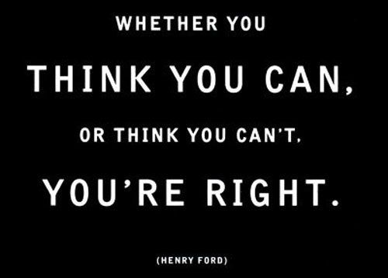
THANK YOU!!!

